Slide 1
Software Quality Issues in Collaborative Development
Charles Stevenson, Stephen Sallas, Aaron Smith, and Xuan Hoa Ho
10/13/2021
Notes:
Over the years, software development has become increasingly difficult for just one person to take on, so it became necessary for developers to collaborate on a project together. Collaborative development is a powerful tool that can be used to create software that is as good as possible. By having multiple developers work on the same piece of software, there can be a higher chance that bugs are fixed and the developers can be more confident that their software meets all requirements given to them. However, working with multiple people on the same project can lead to differences in things such as coding styles, structure, and work practices. In a study conducted by Gutwin, Penner, and Schneider [1], they found that unless developers “maintain both a general awareness of the entire team and a more detailed awareness of people they plan to work with,” they are more likely to spend time working on things that are already being done by another team member, or making changes that will cause other changes to stop working. Collaborative development takes less time actually writing code, but takes far more time in the planning stages in order to be effective. In a study conducted by Storey, Ryall, and Bull [2], research was done on how task annotations in the source code plays a role in the effective implementation of code by multiple creators in open source projects, the largest example of distributed development. Issues arose when these ‘informal’ annotations could have different meanings dependent on the team or individual parsing them. Well-handled project management can certainly make a distributed code base easier to manage, as found by Zhang et. al. [3]. In the duration of the ~3 month study, project managers were interviewed, discussing processes, problems, and requirements, and then shadowed, tracking the time they needed to gather information about the product and inform team members and external individuals such as the vendor about updates to the product. While there is a large interest in collaboration frameworks and development strategies such as Scrum, Agile, etc, there is currently no “best” way to compile these ideologies. This can lead to a difference in development strategies and disconnect between members of the same team, especially in a distributed development environment.

Slide 2
Table of Contents
Information Access (Stephen Sallas)
Updated Notification (Stephen Sallas)
Communication (Xuan Hoa Ho)
Group Awareness (Xuan Hoa Ho)
Privacy and Security Issues (Henry Stevenson)
Lack of Developers (Aaron Smith)
Solutions/Recommendations (Aaron Smith)
Sources (All)

Slide 3

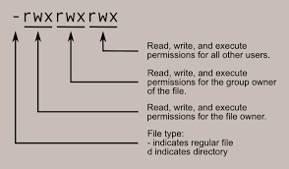

Information Access
Two important aspects: granting access & restricting access
Granting access is vital because all team members need constant access to the most up-to-date version of the project they are working on
Restricting access is important because team members need to be able to protect their own work from being altered or deleted
Google Doc Editors, Unix/Linux permissions, and Git

Slide 4





Updated Notification
The process of notifying a collaborative team member when a significant change has occurred
Notifications can be processed and sent through instant messaging, emails, meeting, etc.
High volume of notifications can result in issues
Meetings are efficient in delivering notifications, but take time and decrease productivity

Slide 5
Communication
Important: “the software life cycle requires a great deal of communication between those members involved in the development" (Minguel, page 5-6)
Cultural differences
Different terminologies may cause misunderstanding in the message and translation errors
Misunderstand the requirements (Bad)
Misunderstand the leader instruction (Bad)
Security of communication must also take into account
Eavesdrop and know the details about the conversation
Imitate/Steal works

Slide 6
Group Awareness
Important: Need to know about the status of the project, especially the changes to make a realistic assumptions about the project
Due to frequent changes, lack of continuity in communication, and lack of collaborative tool,
Unaware of the progress.
Cannot work efficiently and productively
Work on the same aspect of the project
Missing specific aspect of the project
Falling behind the schedule
Etc.

Slide 7

Privacy and Security Issues
Fewer to no legal obligations with regards to open-source projects
Many teams which work exclusively remotely have insufficient or non-existent code review practices, which can lead to the software functioning incorrectly or not at all, or leading to security breaches.
License Incompatibility

Slide 8

Lack of Developers
Some developers have no interest in collaboration.
Be the developer you want to collaborate with!
Collaboration is difficult and many don’t want to deal with it.
Lack of structure
Causes projects to fail!

Slide 9
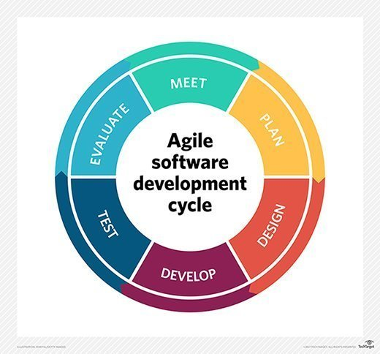
Solutions/Recommendations
Communication
Make the requirement easily understood
Identify dependencies among modules
Propose a technique and groupware
Coordination and communication
Success rate can be increased with communication
Bug tracking mechanisms
Further helps developers locate and identify bugs
Managed by a skilled leader
Capable of handling a variety of people
Different Development Methodologies
Can be beneficial for remote development
“Agile” methodology

Slide 10
Sources
Yasrab, R., Ferzund, J., & Razaaq, S. (2019, March 19). CHALLENGES AND ISSUES IN COLLABORATIVE SOFTWARE DEVELOPMENTS. ArXiv. Retrieved October 13, 2021, from https://arxiv.org/ftp/arxiv/papers/1904/1904.02720.pdf.
Amrit C. and Hillegersberg J. - Detecting Coordination Problems in Collaborative Software Development Environments, Information Systems Management, (2008), 25(1), 57-70.
DeFranco-Tommarello J. and Deek F. P. - Collaborative Software Development: A Discussion of Problem Solving Models and Groupware Technologies, System Sciences, Proceedings of the 35th Annual Hawaii International Conference, 2002, 568-577
Minguel, J., Mario, P., &Aurora, V. “Challenged and Improvements in Distributed Software Development: A Systematic Review”. Advances in Software Engineering, Volume 2009. https://www.researchgate.net/publication/26850416_Challenges_and_Improvements_in_Distributed_Software_Development_A_Systematic_Review

